Slide 1
Prediction of Seasonal vaccine uptake
BY Lorna Gatimu

Slide 2
Table of Contents
1
Business and Data Understanding
2
Modelling
3
Evaluations
4
Conclusions and Recommendations

Slide 3
Business and Data Understanding
Business Understanding
Goal: Predict whether individuals will take the seasonal flu vaccine based on demographics, socioeconomic factors, and behaviors.
Business Objective: Improve vaccination rates by identifying individuals likely to get vaccinated.
Key Benefit:
Enable targeted interventions to encourage vaccination.
Improve public health outcomes.
Reduce healthcare costs associated with flu-related illnesses.

Slide 4
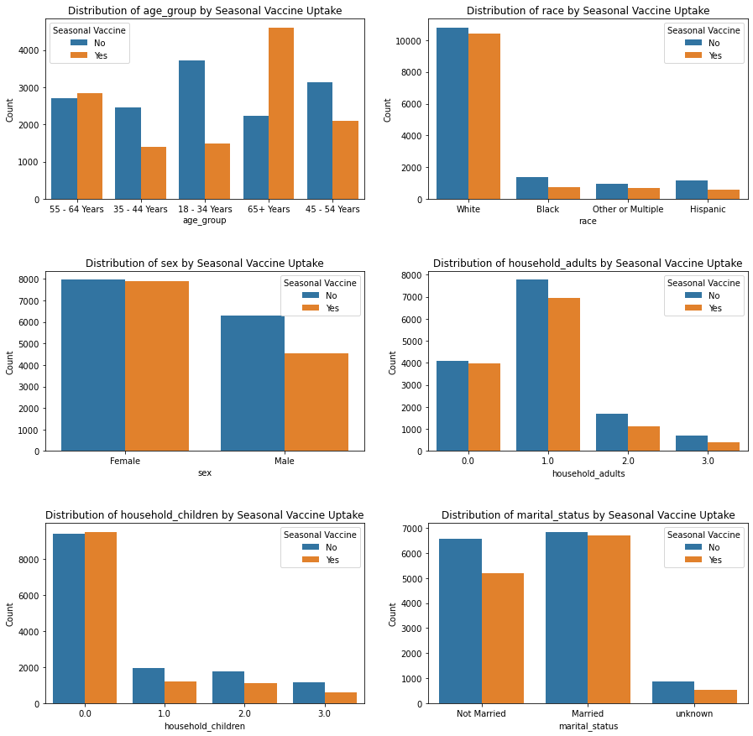
Business and Data Understanding
Data Understanding

Slide 5
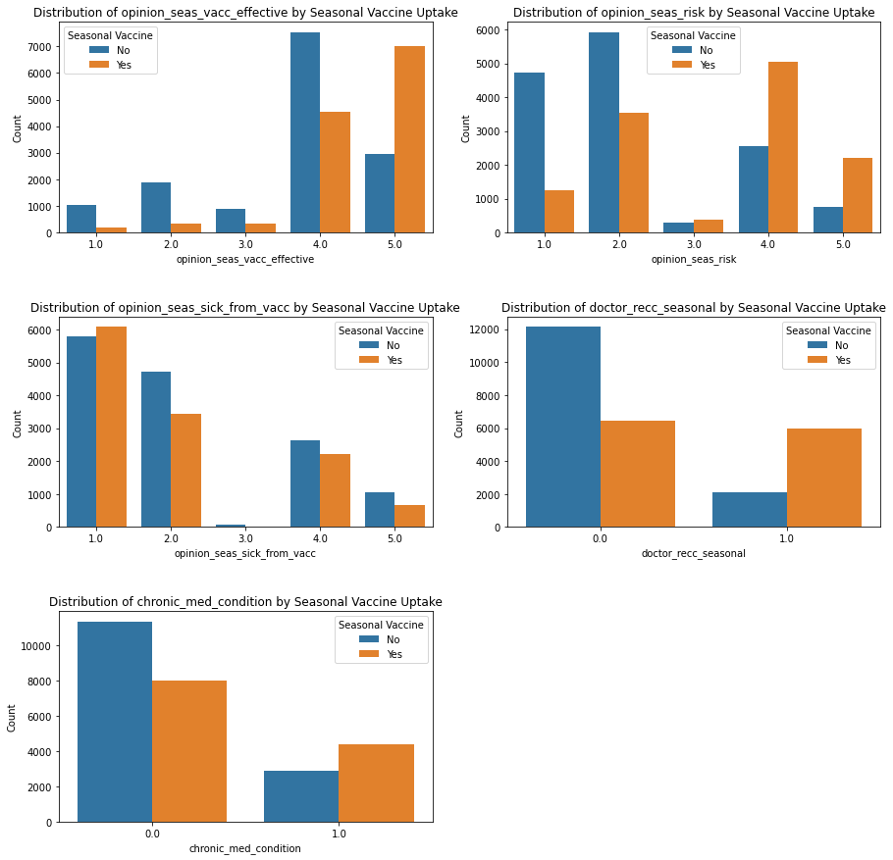
Business and Data Understanding
Data Understanding

Slide 6
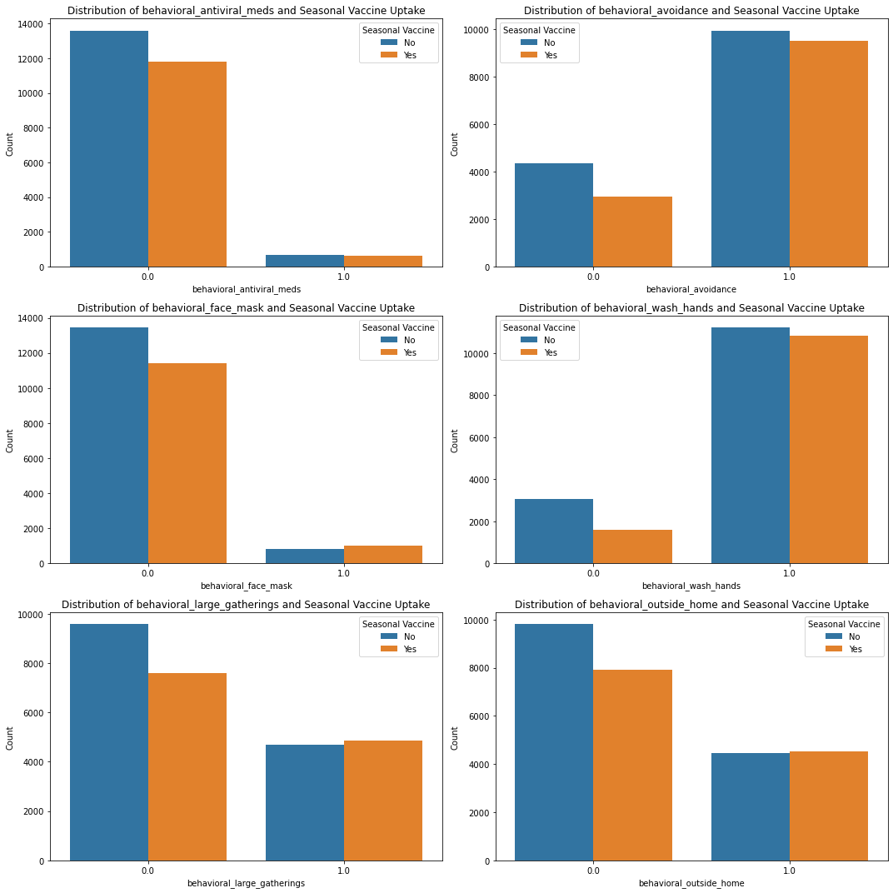
Business and Data Understanding
Data Understanding

Slide 7
Modelling

Slide 8
Baseline Model: The Dummy Classifier (baseline) has limited predictive value, with a high recall (100%) but low precision (45.81%), resulting in an F1-Score of 62.84%. It predicts all instances as vaccinated, which is not practical.
Logistic Regression: This model is the strongest, with an accuracy of 80.7%, precision of 80.6%, and recall of 76.0%. Its F1-Score of 78.3% and ROC AUC of 0.876 indicate strong performance in distinguishing between vaccinated and non-vaccinated individuals. It's preferred for its simplicity and interpretability.
Random Forest: With an accuracy of 80.1%, precision of 79.2%, and recall of 76.8%, Random Forest performs similarly to Logistic Regression. Its F1-Score is 78.0% and ROC AUC is 0.874. It is useful for more complex, non-linear relationships.
Decision Trees: Decision Trees performed slightly worse than Logistic Regression and Random Forest, with an accuracy of 77.5% and recall of 72.0%. The ROC AUC score of 0.849 suggests lower class discrimination but still a functional model.
ROC Curve and Class Discrimination: All models (except baseline) show strong performance in distinguishing between classes, with ROC AUC scores above 0.8.
Real-World Application: Logistic Regression is ideal for simple, interpretable models, while Random Forest can handle more complexity. Decision Trees may be less favorable unless simplicity is prioritized.

Slide 9
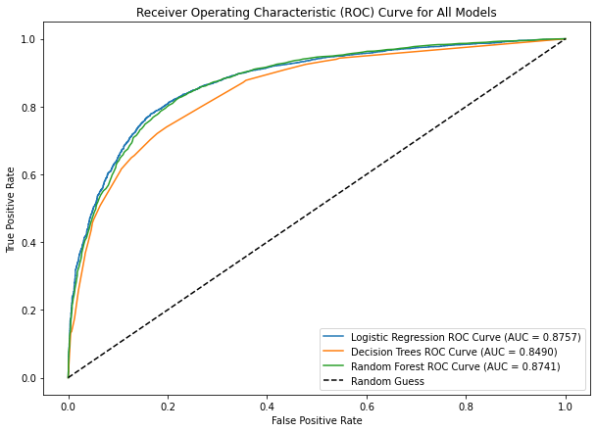

Slide 10
CONCLUSIONS AND RECOMMENDATIONS
Conclusion:
Baseline Model: Simple reference model, predicting everyone will get vaccinated.
Logistic Regression: Promising results, good prediction accuracy.
Decision Tree: Less accurate but still viable for predicting vaccine uptake.
Random Forest: Best overall performance, strong ability to predict vaccine uptake.
Recommendations:
Improving Vaccination Rates: Target at-risk individuals with personalized communication and incentives.
Tailored Campaigns: Use Logistic Regression and Random Forest for targeted educational campaigns and reminders.
Resource Allocation: Efficiently allocate resources by focusing on segments predicted to need intervention.
Continuous Improvement: Regularly monitor and retrain models to maintain prediction accuracy as trends change.

Slide 11
THANK YOU!!!!

